Slide 1

VGG 16
Beny Kaushansky

Slide 2
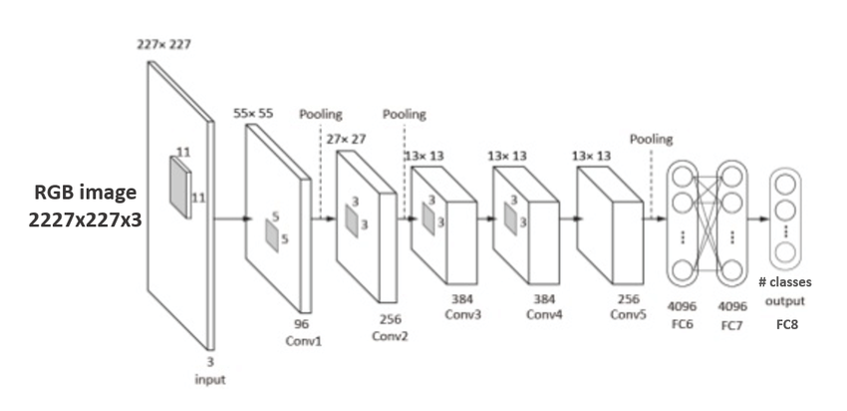
Brief History
Was introduced by the Visual Geometry Group in 2014 for the ImageNet Large Scale Visual Recognition Challenge
The achieves almost 92.7% top-5 test accuracy in ImageNet
Was made as an improvement to “AlexNet” which had five convolution layers and three fully connected layers.

Slide 3
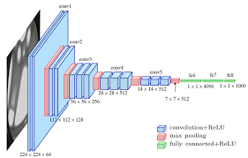
VGG-16 Architecture
Input – 224* 224 image
16 layers total
13 convolution layers followed by
ReLU
5 max pulling layers
3 fully connected layers
has about 138 million parameters

Slide 4
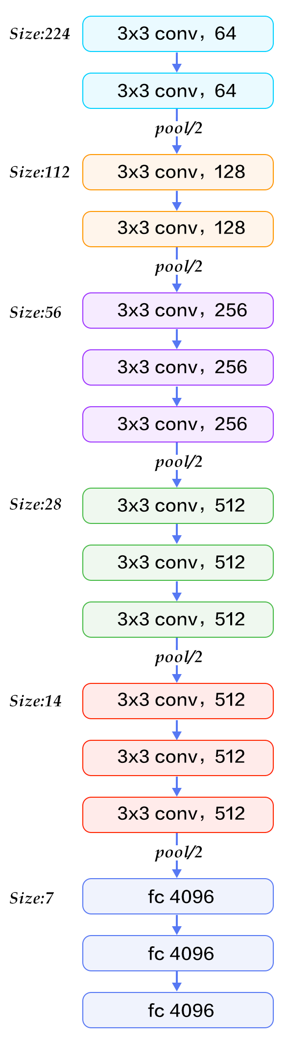
VGG-16 Architecture
Convolution layers:
3*3 kernel size
1 pixel stride
Max pulling layers:
Each down sampling the picture my half
2*2 kernel size
2 pixel stride
Fully connected layers:
First two have 4096 channels, the third one has 1000 channels –
one for each class in the ImageNet database

Slide 5
VGG-16 Architecture
The convolutional layers act as feature detectors, capturing patterns such as edges,
textures, and shapes in various parts of the image
The ReLU activation function is applied after each convolutional layer, introducing
non-linearity and enhancing the network's ability to learn complex features
The fully connected layers at the end of the network serve as the
classifier, leveraging the extracted features to make predictions about
the input images class from the list of known classes

